Slide 1
Cost analysis of hash collisions:
Will quantum computers make SHARCS obsolete?
[Bernstein 2009]
Presentation by Ray Perlner

Slide 2
Motivation
Quantum Computing has major effects on hardness assumptions in cryptography
  Exponential Speedup for integer factorization and discrete log problems [Shor 1994]
  Polynomial Speedup for brute force key search [Grover 1996]
But this talk is primarily about hash functions:
  Brute force collision search on an n-bit hash function costs 2^{n/2} operations classically.
  Brassard, Hoyer, and Tapp [BHT 1998] claimed to reduce this to 2^{n/3} by using quantum computation.
  Is the BHT attack really cheaper than the classical attack?

Slide 3
Outline
Classical Attacks
  Guessing
  Tables
  Parallel Tables
  Pollard Rho
  Van Oorschot-Wiener
Quantum Attacks
  Quantum Computation
  Grover’s algorithm
  BHT algorithm
  Parallelizing Grover’s algorithm
  Parallelizing BHT
Comparisson
  Ignoring Communication
  With communication
Implications
  Is BHT a real quantum speedup?
  Is Grover speedup as advertised?

Slide 4
Classical Attacks

Slide 5
Guessing
If you pick two random messages, the probability their hashes collide is 1/2^{n}.
Thus, you can find a collision by trying 2^{n} message pairs.
This requires ~1 space and ~2^{n} time.
This can be parallelized M ways, resulting in 2^{n}/ M time.
  (Parallel Guessing)

Slide 6
Tables
Store computed hash values in a sorted list.
Checking whether a hash value is in the list requires only logarithmic time (binary search.)
Result: Time = ~2^{n}/Space
  E.g. Time = ~2^{n/2} ; Space = ~2^{n/2}.

Slide 7
Parallel Tables
Create M separate threads accessing shared memory in parallel.
Use the memory to store a sorted list of hash values of size M.
Time = ~2^{n}/M²; Space = ~M.

Slide 8
Pollard Rho
[Pollard 1975]
Iterating H(H(…(H(x₀)…) should loop after ~2^{n/2} steps.
To detect this, keep two threads
  Both start with the same value x₀.
  First thread hashes once per iteration
  Second thread hashes twice per iteration.
  When thread two laps thread one, the two threads will have the same hash value.
Time = ~2^{n/2}; Space = ~1

Slide 9
Parallel Rho
[Van Oorschot Wiener 1994]
Each of M threads picks, and remembers, a random starting point x_{i}.
Each thread iteratively hashes x_{i} until it reaches a “distinguished point” with n/2 – log₂(M) leading zeroes.
The threads then collectively sort their outputs to find colliding distinguished points, y_{i}, y_{j}.
Two threads iteratively recompute hashes of x_{i}, x_{j} to find the hash collision.
Time = ~2^{n/2}/ M; Space = ~M.
x₀
(0 | y₀)
x₁
(0 | y₁) = (0 | y₂)
x₂
x₃
(0 | y₃)

Slide 10
Quantum Attacks

Slide 11
Quantum Computing: Basics
Each physical unit of a classical computer represents a bit.
Each physical unit of a quantum computer represents a qubit.
Measurement turns a qubit into a classical bit. (This is lossy.)
Measurements of different qubits may be correlated (the qubits are “entangled.”)
→ It is easier to describe N qubits as a unit, rather than individually.

Slide 12
Quantum Computing: Describing Qubits
The state of an n-qubit system may be described as a 2^{n}-dimensional unit vector with complex coefficients:
  Define a basis vector for each n-bit classical state:
  |00> = (1, 0, 0, 0) |01> = (0, 1, 0, 0)
  |10> = (0, 0, 1, 0) |11> = (0, 0, 0, 1)
  The state of n qubits may be represented as a linear combination (“superposition”) of these:
  e.g. 1/2(|00> + |01> - |10> +i|11>)

Slide 13
Quantum Computing: Measurement
Measurement of one of the qbits results in one of two outcomes (0 or 1.) Either way:
  State is projected onto the subspace where the relevant qubit has the measured value
  Outcome probability is the square of the (unnormalized) length of the projection.
Ex. ½ (|00> + |01> - |10> + i|11>), measure 2nd qbit
→1/sqrt(2) (|00> - |10> ) (zero) p = 50%
or
→1/sqrt(2) ( |01> + i|11>) (one) p = 50%

Slide 14
Quantum Computing: Operations (gates)
Linear
F (a|x> +b|y>) = a (F|x>) +b(F|y>)
  This means F can be defined by what it does to (e.g.) classical states.
Unitary (Information Preserving)
  Change of orthonormal basis (coordinate system – like rotating the axes in 3 space)
  Includes all reversible classical operations
Local
  Acts on only 1 or 2 qubits at a time. (locality defined by direct product)
F |x> = |y> → F_{i}|x_{i};env> = F_{i} (|x_{i}> ⊗|env>) = |y_{i};env> = |y_{i}> ⊗|env>)
  ⊗ (direct product) concatenates labels and distributes over +.
  An unentangled state can be described as a direct product of individual qbits.

Slide 15
Example Operation CNOT
Derived from a classical 2 bit operation:
(a, b) → (a, a ⊕ b)
|00> → |00> |01> → |01>
|10> → |11> |11> → |10>
e.g. ½ (|00> + |01> - |10> + i|11>)
→½ (|00> + |01> - |11> + i|10>)

Slide 16
Example operation Hadamard
Distinctly non-classical 1 qbit operation.
Self Inverse (We use this later.)
|0> → 1/sqrt(2)(|0> + |1>)
|1> → 1/sqrt(2)(|0> - |1>)
e.g. 3/5|0> + 4/5|1>
→sqrt(2)/10 (3(|0>+|1>) + 4(|0>-|1>))
= sqrt(2)/10 (7|0> - |1>)

Slide 17
Grover’s algorithm
Finds a unique value for which a classical function f (acting on 0…N-1) returns 1.
Start in the state:
1/sqrt(N) (|0> + |1> + …+|N-1>)
Use f to increase the amplitude of |f⁻¹(1)> at the expense of all others.

Slide 18
Grover’s algorithm
Fundamental trick: because f is computable, we can do something different to the state |f⁻¹(1)>:
|0…0> → |0...0>; |0…1> → |0…1> etc.
but |f⁻¹(1)> → - |f⁻¹(1)> !
Since we can map |0…0> to and from a superposition of all states, and we can construct a classical function to detect |0…0>,
We can also negate the amplitude of this “sum of states”, s
Grover’s algorithm actually calls for negating the amplitude orthogonal to s, but that’s just as easy.

Slide 19
Grover’s algorithm:
Creating a superposition of all states from 0 to 2^{n}-1
Start in |00…0>
Perform a Hadamard on each qubit
Result:
2^{-n/2}(|0>+|1>)⊗(|0>+|1>)⊗…⊗(|0>+|1>)
→This is the state we want:
2^{-n/2}(|0…0> + |0…1> +…+ |1…1>)
The Hadamard gate is self inverse, so doing this again gets us back to
|00…0>

Slide 20
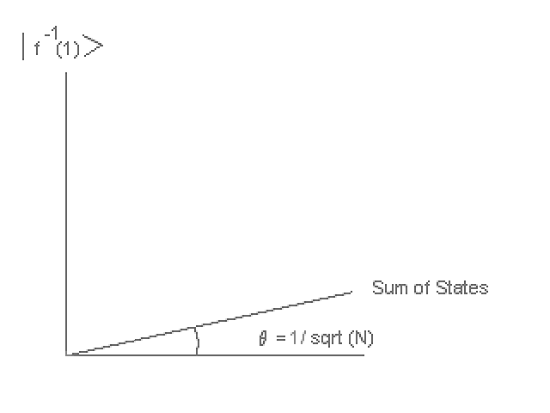
Grover’s Algorithm

Slide 21
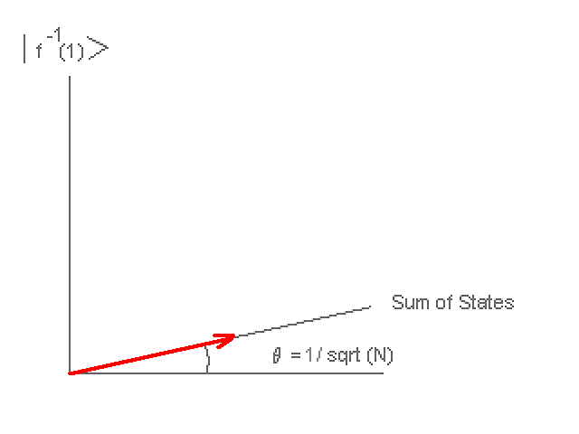
Grover’s Algorithm

Slide 22
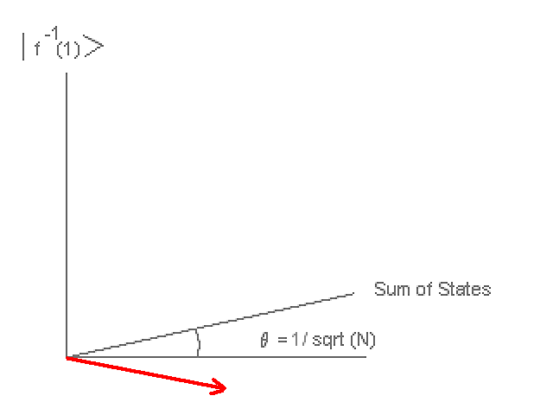
Grover’s Algorithm

Slide 23
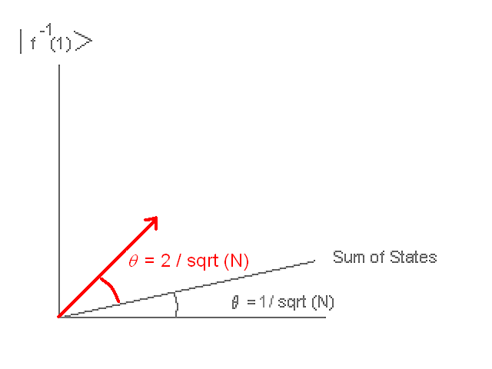
Grover’s Algorithm

Slide 24
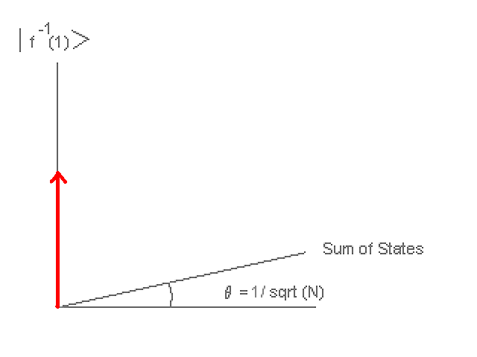
Grover’s algorithm

Slide 25
Things Should Get Easier from Here on in.

Slide 26
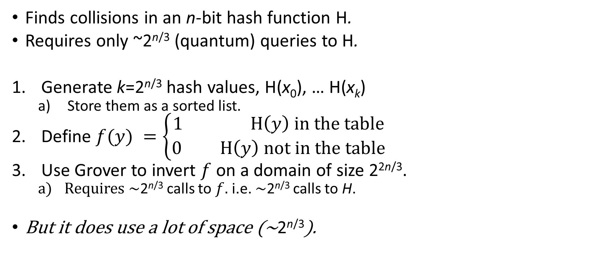
BHT Algorithm
Finds collisions in an n-bit hash function H.
Requires only ~2^{n/3} (quantum) queries to H.
Generate k=2^{n/3} hash values, H(x₀), … H(x_{k})
  Store them as a sorted list.
Define $f(y) =\left\{\begin{matrix}1 H\left(y\right) in the table \\ 0 H\left(y\right) not in the table\end{matrix}\right.$
Use Grover to invert $f$ on a domain of size 2^{2n/3}.
  Requires ~2^{n/3} calls to $f$. i.e. ~2^{n/3} calls to H.
But it does use a lot of space (~2^{n/3}).

Slide 27
Memory vs Parallelization
If we can afford so much memory, maybe we can afford more processors?
Traditionally, we’ve assumed RAM is cheaper than CPU for classical computers
  Maybe not so true. A lot of published attack implementations use more distributed architectures (GPU clusters, ASICs etc.)
In the quantum case, we’re already doing parallel processing for error correction.
Quantum accessible Classical Memory (e.g. CDROM)
  Aim a laser at many addresses in superposition.
  Gates for addressing (at least) need to be quantum, and so need error correction.
  So, even this probably doesn’t buy much.
Probably best to assume that memory and processors cost about the same.

Slide 28
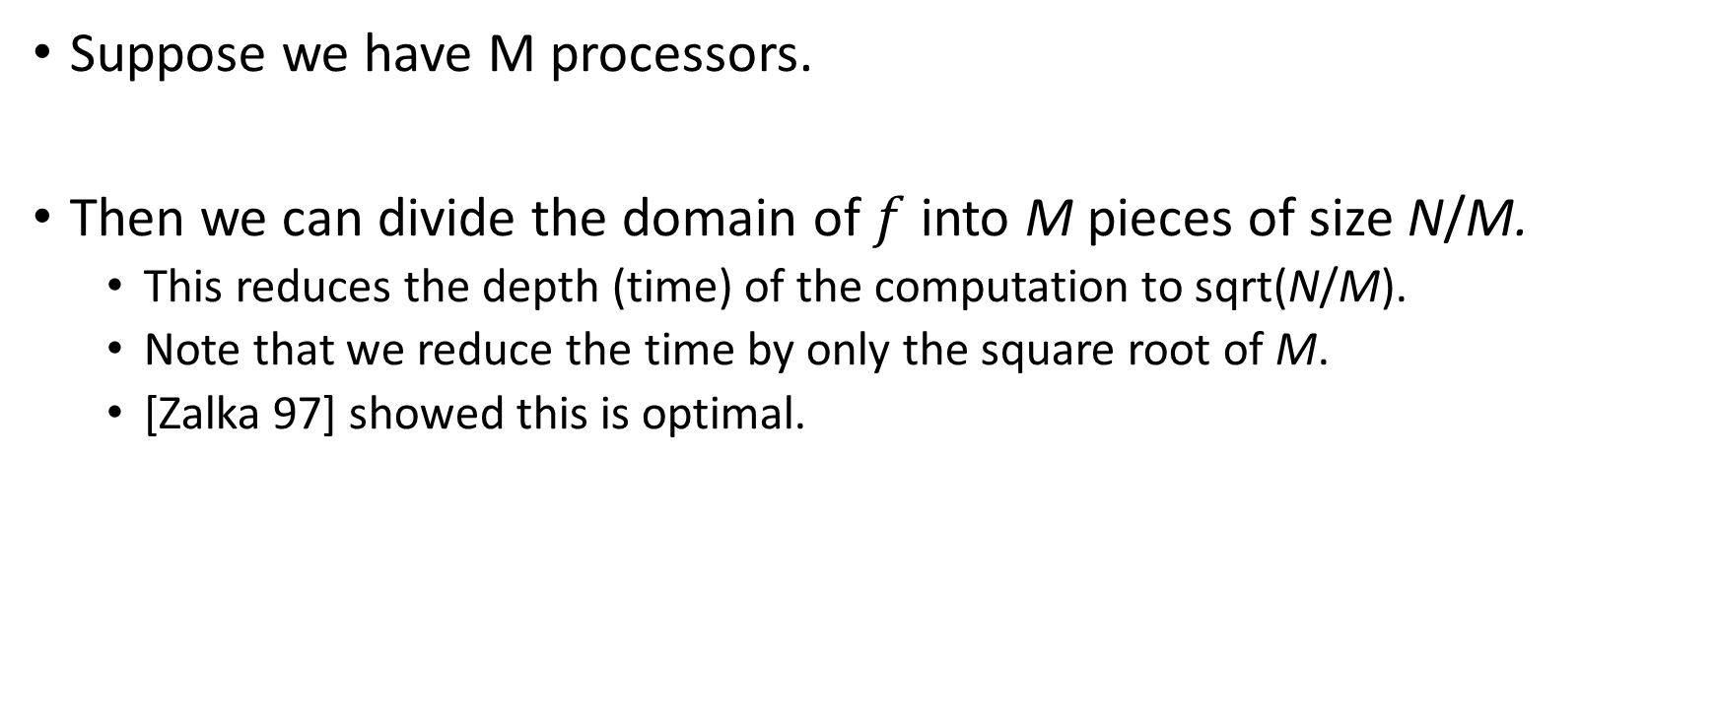
Parallelizing Grover’s algorithm
Suppose we have M processors.
Then we can divide the domain of $f$ into M pieces of size N/M.
  This reduces the depth (time) of the computation to sqrt(N/M).
  Note that we reduce the time by only the square root of M.
  [Zalka 97] showed this is optimal.

Slide 29
Parallelizing BHT
In a naïve implementation, M instances of BHT would require M*2^{n/3} space.
Classically, multiple threads can access the same RAM in parallel at minimal cost.
[Beals et al. 2012] showed you could do the same with quantum memory.
Thus we can parallelize the Grover step 2^{n/3} ways at minimal cost.
  Result: 2^{n/3} space, 2^{n/6} time.
  Similar results possible with time*space = ~2^{n/2}.
  Note: Assumes (unrealistically) that communication is free.
This variant of BHT was considered by Bernstein as “parallel quantum tables.”

Slide 30
Comparison
(Assuming Free Communication)

Slide 31
Comparison
(Realistic Communication)

Slide 32
Implications
BHT is not a real quantum speedup
  Only works if you assume memory is free, but parallelization is impossible.
    Unrealistic even for classical computing, but ridiculous for quantum computing.
  If you assume (as you should) that memory access times scale with distance, it gets even worse in comparison to classical algorithms
  Quantum gates probably also cost more than classical gates, but even without this, the argument holds.
Even Grover’s algorithm probably isn’t so large a speedup in practice
  Still suffers from poor parallelization.
  Still uses potentially expensive quantum gates.

Slide 33
Discussion
Questions? Comments?
Thank You!

Slide 34
Bibliography
[Bernstein 2009] https://cr.yp.to/hash/collisioncost-20090517.pdf
[Shor 1994] http://www.csee.wvu.edu/~xinl/library/papers/comp/shor_focs1994.pdf
[Grover 1996] https://arxiv.org/abs/quant-ph/9605043
[BHT 1998] https://arxiv.org/abs/quant-ph/9705002
[Pollard 1975] http://www.cs.cmu.edu/afs/cs/academic/class/15451-f11/www/lectures/lect1122_Pollard.pdf
[Van Oorschot-Weiner 1994] http://people.scs.carleton.ca/~paulv/papers/acmccs94.pdf
[Beals et al. 2012] https://arxiv.org/abs/1207.2307

